Slide 1
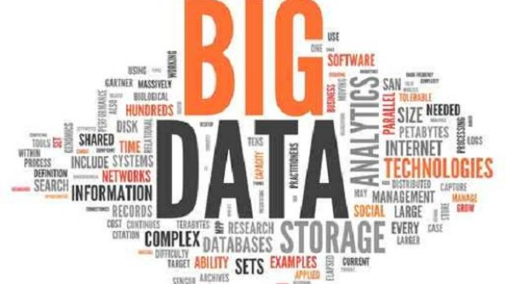

Slide 2
BIG DATA
A PROBLEM

Slide 3
BIG DATA
Big data is a term for data sets that are so large or complex that traditional data processing application softwares are inadequate to deal with them.
Challenges include capture, storage, analysis, search, sharing, transfer, visualization, querying, updating and information privacy.
The term "big data" often refers simply to the use of predictive analytics, user behavior analytics, or certain other advanced data analytics methods that extract value from data, and seldom to a particular size of data set.

Slide 4
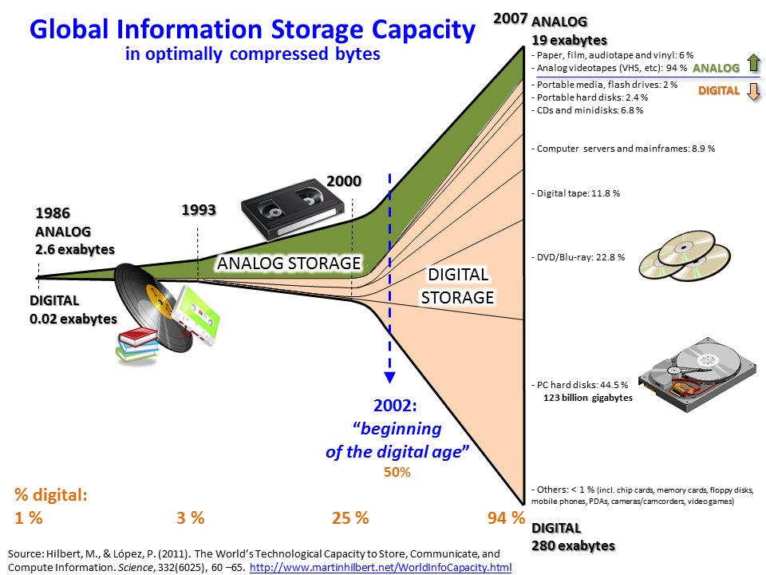
BIG DATA

Slide 5
WHY THIS BIG DATA
Over 2.5 Exabyte(2.5 billion gigabytes) of data is generated every day. Following are some of the sources of the huge volume of data:
A typical, large stock exchange captures more than 1 TB of data every day. There are around 5 billion mobile phones (including 1.75 billion smart phones) in the world.
YouTube users upload more than 48 hours of video every minute.
Large social networks such as Twitter and Facebook capture more than 10 TB of data daily.
There are more than 30 million networked sensors in the world.

Slide 6
4V’s BY IBM
Volume
Velocity
Variety
Veracity

Slide 7
IBM’s definition
Volume:- Big data is always large in volume. It actually doesn't have to be a certain number of petabytes to qualify. If your store of old data and new incoming data has gotten so large that you are having difficulty handling it, that's big data. Remember that it's going to keep getting bigger.

Slide 8
IBM’s definition
Velocity :-Velocity or speed refers to how fast the data is coming in, but also to how fast we need to be able to analyze and utilize it. If we have one or more business processes that require real-time data analysis, we have a velocity challenge. Solving this issue might mean expanding our private cloud using a hybrid model that allows bursting for additional compute power as-needed for data analysis.

Slide 9
IBM’s definition
Variety:- Variety points to the number of sources or incoming vectors leading to databases. That might be embedded sensor data, phone conversations, documents, video uploads or feeds, social media, and much more. Variety in data means variety in databases – we will almost certainly need to add a non-relational database if you haven't already done so.

Slide 10
IBM’s definition
Veracity :-Veracity is probably the toughest nut to crack. If we can't trust the data itself, the source of the data, or the processes we are using to identify which data points are important, we have a veracity problem. One of the biggest problems with big data is the tendency for errors to snowball. User entry errors, redundancy and corruption all affect the value of data. We must clean our existing data and put processes in place to reduce the accumulation of dirty data going forward.

Slide 11
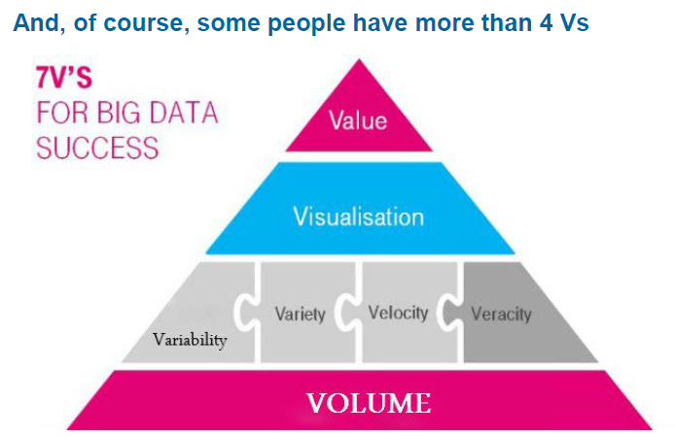

Slide 12
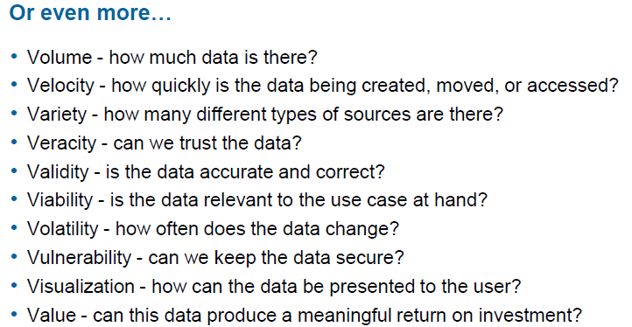

Slide 13
Types of Data
Structured data:
Data which is represented in a tabular format
E.g.: Databases
Semi-structured data:
Data which does not have a formal data model
E.g.: XML files
Unstructured data:
Data which does not have a pre-defined data model
E.g.: Text files

Slide 14
Structured Data
Structured data refers to kinds of data with a high level of organization, such as information in a relational database.
When information is highly structured and predictable, search engines can more easily organize and display it in creative ways.
Structured data markup is a text-based organization of data that is included in a file and served from the web.

Slide 15
Semi-structured data
It is a form of structured data that does not conform with the formal structure of data models associated with relational databases or other forms of data tables.
But nonetheless contains tags or other markers to separate semantic elements and enforce hierarchies of records and fields within the data. Therefore, it is also known as self-describing structure.
In semi-structured data, the entities belonging to the same class may have different attributes even though they are grouped together.

Slide 16
Unstructured data
It refers to information that either does not have a pre-defined data model or is not organized in a pre-defined manner.
It is typically text-heavy, but may contain data such as dates, numbers, and facts as well.
This results in irregularities and ambiguities that make it difficult to understand using traditional programs as compared to data stored in fielded form in databases or annotated (semantically tagged) in documents.

Slide 17
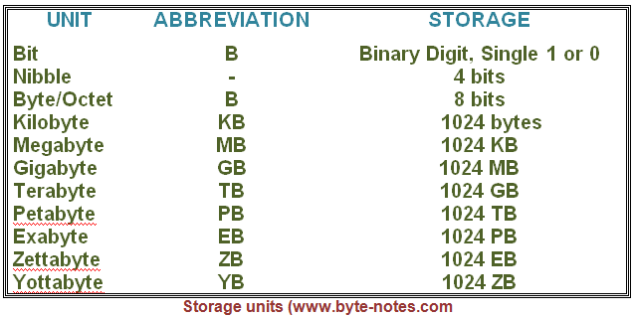

Slide 18
WHAT IS HADOOP
Hadoop is an open source, Java-based programming framework that supports the processing and storage of extremely large data sets in a distributed computing environment. It is part of the Apache project sponsored by the Apache Software Foundation.
It consists of computer clusters built from commodity hardware.
All the modules in Hadoop are designed with a fundamental assumption that hardware failures are common occurrences and should be automatically handled by the framework.
The core of Apache Hadoop consists of a storage part, known as Hadoop Distributed File System (HDFS), and a processing part which is a MapReduce programming model.

Slide 19
WHAT IS HADOOP
Hadoop splits files into large blocks and distributes them across nodes in a cluster.
It then transfers packaged code into nodes to process the data in parallel. This approach takes advantage of data locality – nodes manipulating the data they have access to – to allow the dataset to be processed faster and more efficiently than it would be in a more conventional supercomputer architecture that relies on a parallel file system where computation and data are distributed via high-speed networking.

Slide 20
Core components of Hadoop
Hadoop Distributed File System (HDFS) – a distributed file-system that stores data on commodity machines, providing very high aggregate bandwidth across the cluster.
Hadoop MapReduce – an implementation of the MapReduce programming model for large scale data processing.

Slide 21
HISTORY OF HADOOP
The genesis of Hadoop came from the Google File System paper that was published in October 2003.
This paper spawned another research paper from Google – MapReduce: Simplified Data Processing on Large Clusters.
Development started on the Apache Nutch project, but was moved to the new Hadoop subproject in January 2006.
Doug Cutting, who was working at Yahoo! at the time, named it after his son's toy elephant.

Slide 22
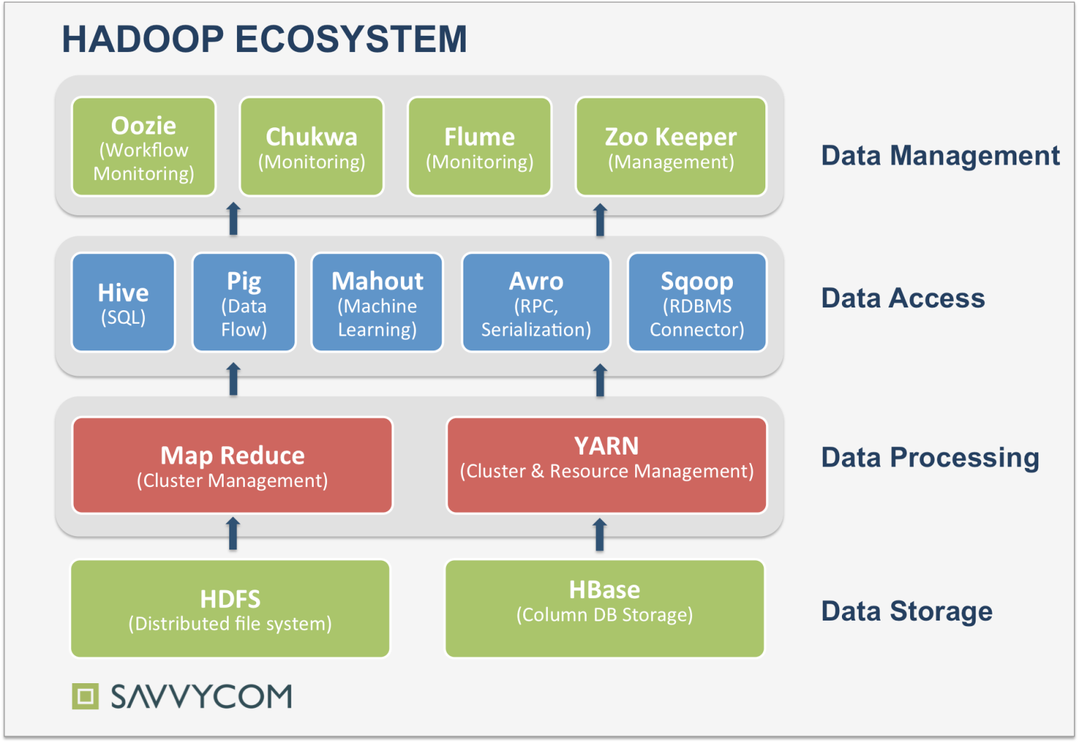
HADOOP-ECOSYSTEM

Slide 23
CORE COMPONENTS-HDFS
Hadoop File System was developed using distributed file system design.
It is run on commodity(
PCs which can be used to make a cluster ) hardware.
Unlike other distributed systems, HDFS is highly fault tolerant and designed using low-cost hardware.
HDFS holds very large amount of data and provides easier access.
To store such huge data, the files are stored across multiple machines.
HDFS also makes applications available to parallel processing.

Slide 24
Features of HDFS
It is suitable for the distributed storage and processing.
Hadoop provides a command interface to interact with HDFS.
The built-in servers of namenode and datanode help users to easily check the status of cluster.
Streaming access to file system data.
HDFS provides file permissions and authentication.

Slide 25
Modes of Hadoop configuration
1)Standalone mode
All Hadoop services
run in a
single JVM, on a
single machine

Slide 26
Pseudo distributed mode
Individual Hadoop services run in an individual JVM, but on a single machine

Slide 27
Fully distributed mode
Hadoop services run
in different JVMs, but belong to one cluster.

Slide 28
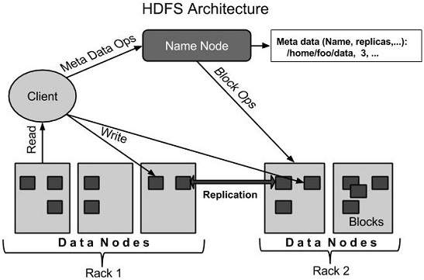
HDFS Architecture

Slide 29
NAMENODE
HDFS follows the master-slave architecture and it has the following elements.
Node - Commodity servers interconnected through a network device
Namenode
The namenode is the commodity hardware that contains an operating system and the namenode software.
It is a software that can be run on commodity hardware.

Slide 30
NAMENODE
The system having the namenode acts as the master server and it does the following tasks:
Manages the file system namespace.
Regulates client’s access to files.
It also executes file system operations such as renaming, closing, and opening files and directories.

Slide 31
DATANODE
The datanode is a commodity hardware having any operating system and datanode software. For every node (Commodity hardware/System) in a cluster, there will be a datanode. These nodes manage the data storage of their system.
Datanodes perform read-write operations on the file systems, as per client request.
They also perform operations such as block creation, deletion, and replication according to the instructions of the namenode.

Slide 32
BLOCK
Generally the user data is stored in the files of HDFS. The file in a file system will be divided into one or more segments and/or stored in individual data nodes. These file segments are called as blocks. In other words, the minimum amount of data that HDFS can read or write is called a Block. The default block size is 64MB, but it can be increased as per the need to change in HDFS configuration.

Slide 33
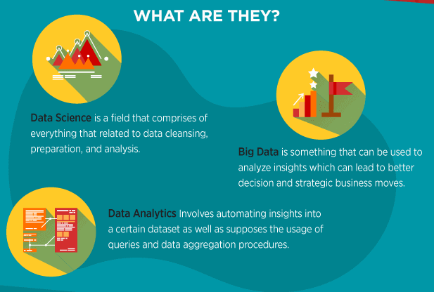
difference between Data science and Bigdata

